Slide 1
ROYAL Furnishers (Pvt) Ltd.
ABDUL RAHEEM RIHAM AHAMED
HND COMPUTING IDM

Slide 2
Table of contents
Requirements of ecommerce website
Short and unique DOMAIN NAME
Web Hosting
Organization Relevant theme
Shopping cart
Quickly responsive design
Ecommerce Strategies
Payment System
References

Slide 3
Requirements of ecommerce website
Learn how to make your small business dreams come true by meeting the following requirements to create an e-commerce website:
Short and unique DOMAIN NAME
Web Hosting
Organization Relevant theme
Shopping cart
Quickly responsive design
Notes:
Every year, new limited liability companies emerge online. Some of them are successful and many fail within five years. For this reason, there is a high level of competition in online stores. Competing as an online business is increasingly difficult. As a business owner who wants to establish an online presence for your brand, you need to build a site properly. Only then can you beat your millions of competitors who are already online.

Slide 4
Short and unique DOMAIN NAME
The main requirement for creating an e-commerce site is a domain name.
I recommend the domain name royalfurniture.com for your company.
The reason for choosing this domain name.
Your shop name
Unique
Small length
Notes:
If you want your business to be online soon, you need to take your time choosing a domain name. Typically, business owners choose to use their business names for domain names. However, in some cases, the names have already been taken. Other times, the names are too long for the name of the website.
If you register a domain name that takes up most of the search bar, consumers will have a hard time remembering it. Also, you cannot register a domain name that is already in use. If you find yourself in one of these situations, you need to take your time and explore new opportunities. For example, you can use abbreviations if your name is too long. Keep your options open when registering a domain name for your e-commerce website.

Slide 5
Web hosting
These essential components of web hosting should include
good timing
fast speed
quality customer
support
scaling.
With your hosting needs in mind, choose a web host that can provide you with these features and more.
I recommend the hosting site https://www.hostgator.com/ for your company.
This site is trusted, cheap price, and provide many customer friendly plans.
Notes:
Quality web hosting is another essential step in creating an ecommerce website. The web host of a site directly affects its success. That being said, you need to make sure that the service you choose provides you with a few essentials. So, you will succeed in creating an e-commerce website that generates traffic.

Slide 6
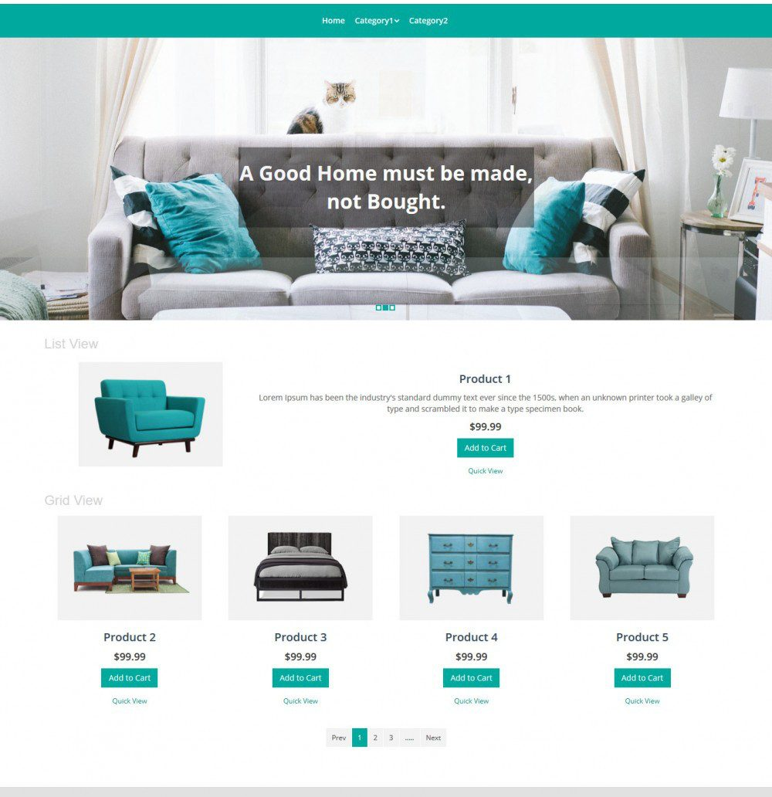
Organization Relevant theme
Basically, You need to effectively design your webpage with a theme related to your business
If this is not the company related design then maybe your problem is:
Consumers will get the feeling that they have gone to a different zone site.
This will reduce consumer attendance
Eventually, there will be a loss in business
Note: The figure is related furniture company eCommerce website design.
Notes:
Make sure your website meets industry standards by visiting your competitors' sites. Identify your themes by looking at their color schemes and formats. You want your site to have a similar feel to profitable sites in the same industry. To achieve this, you must complete the requirement of choosing a relevant topic.

Slide 7
Shopping cart
Every eCommerce website needs a shopping cart
The uses of the shopping cart
Customers safely To purchase the product item.
This way it is more profitable
Notes:
Every e-commerce website needs a shopping cart, so it needs one more to grow. You need to design a secure shopping cart so that your customers can buy your products safely. Consider using an advanced shopping cart design. Updates on upgraded cars include cross-sales. This strategy makes businesses more profitable because it hopes consumers will add more products to their carts before completing the upgrade process. Implement useful tricks like this to build a successful eCommerce website.

Slide 8
Quickly responsive design
This is an added service. This will allow a consumer to clear up any doubts about a product and thus increase your eCommerce reputation among consumers, thereby increasing the consumer revenue of your web page.
Notes:
In addition to the above requirements for creating an e-commerce website, you need a responsive design. While this is not an essential element for all eCommerce sites, it is a must-have feature if you want to build a positive online presence. After all, you can’t buy it if traveling consumers don’t respond to your product. They can visit your site on their mobile devices and easily navigate through it. By using a responsive design for your eCommerce site, you will reach more consumers and sell more products. That is why it is considered an important requirement for any online store.

Slide 9
Ecommerce Strategies
Based on ROYAL FURNISHERS (Pvt) Ltd.
Four positional factors
Technology : Reducing the moisture content to below 15% where by minimizing natural cracking. As they maintain extremely high quality standards
Service : Good Service
Market : Quality controller and Dedicated Sales Team
Brand : Most popular brand in Sri Lanka
Three bonding factors
Leadership
Infrastructure
Organizational learning

Slide 10
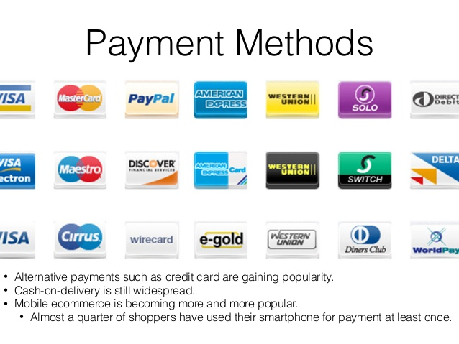
Payment System
Credit Card
Debit Card
Smart Card
E-Money
Cash on Delivery
Notes:
Credit Card : This way bank credit card use to pay.
Debit Card: This way also bank debit card use to pay.
Cash on Delivery: This way use to pay the cash on delivery the product seller

Slide 11
Conclusion
As mentioned above, having a basic e-commerce website will greatly increase its growth. This is because with the proper domain name the consumer can easily enter our eCommerce website and subsequently its designs will attract customers which will not only increase the customer attendance on our website but also make more profit.
Not only this, with the help of an easy payment system it can be easy for the consumers.

Slide 12
References
WEB DESK (2019) 5 Requirements to Develop An eCommerce Website, Available at: https://www.digitalinformationworld.com/2019/12/5-requirements-to-develop-an-ecommerce-website.html (Accessed: 16th April 2021).

Slide 13
THANK YOU

